Slide 1
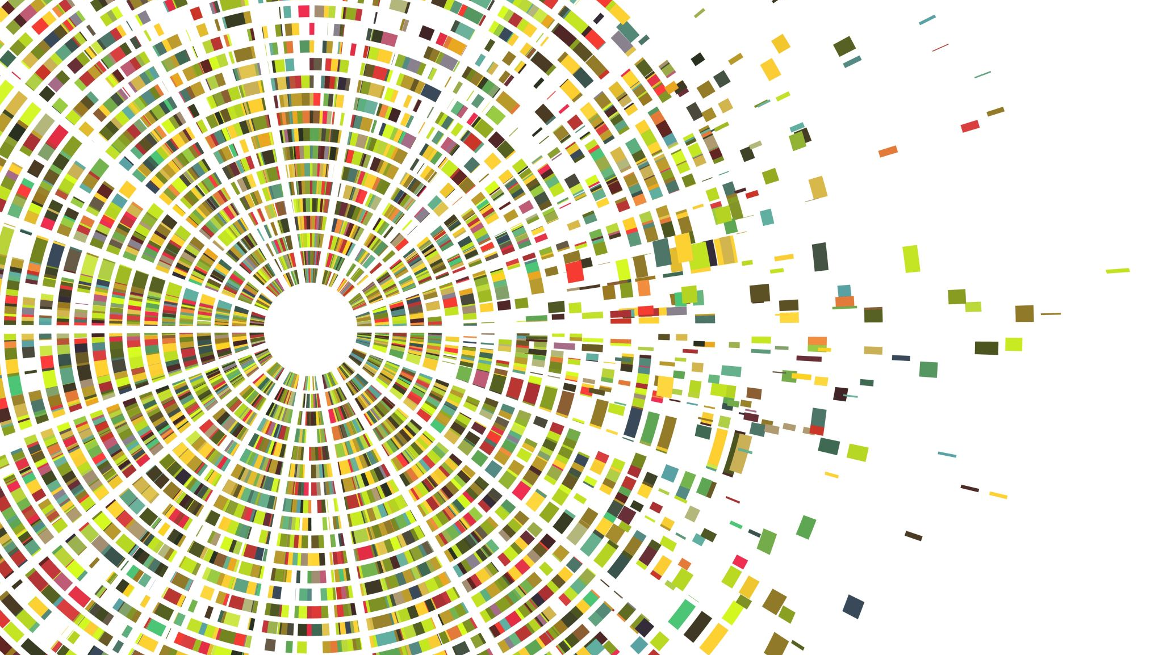
Life Expectancy
Project 1 by Elstan, Lina, and Carmen

Slide 2
Why do I care about this presentation?
We want to find out life expectancy across countries:
what is the healthy life expectancy?
life expectancy between sexes?
how the best country measures against worst?
how the numbers changed throughout time?
how basic drinking water may affect life expectancy?
how sanitation may affect life expectancy?
the difference between rural versus urban areas?

Slide 3
10 Countries (7 top and 3 bottom)
Australia
Canada
Germany
Japan
Switzerland
United Kingdom
United States
8) Liberia
9) Madagascar
10) Nigeria

Slide 4
Data sets
Data source: https://www.kaggle.com/utkarshxy/who-worldhealth-statistics-2020-complete
life expectancy at birth (in years)
healthy life expectancy (HALE) at birth (in years)
population using at least basic drinking water services percentages
population using at least basic sanitation services percentages

Slide 5

Inspiration for this data
“The first episode explores Gates's interest in improving sanitation in developing countries and the development of the "Omni Processor“ - wikipedia

Slide 6
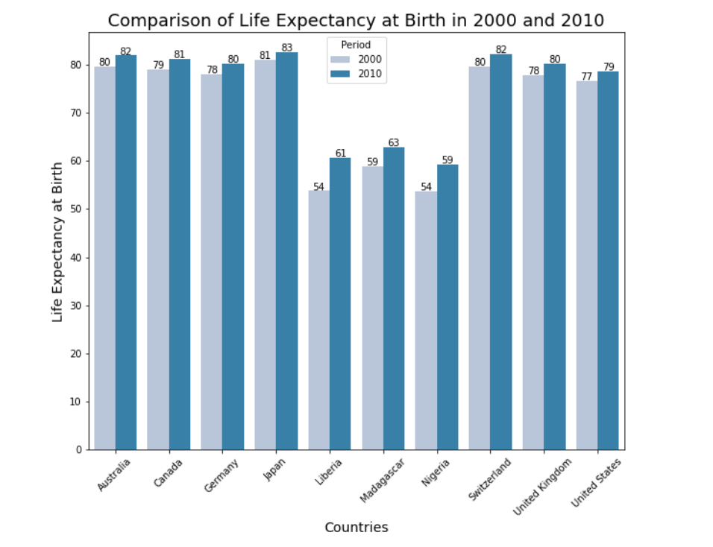
Life expectancy years 2000 versus 2010 - Top 7 countries have higher life expectancy (around 80 years) - Bottom 3 countries have higher life expectancy (around 60 years)
Unites States: 79
Perhaps 10 years later (now) in 2020 the year will also increase?
Definition: Health Adjusted Life Expectancy (HALE)
It adjusts overall life expectancy by the amount of time lived in less than perfect health. This is calculated by subtracting from the life expectancy a figure which is the number of years lived with disability multiplied by a weighting to represent the effect of the disability.

Slide 7
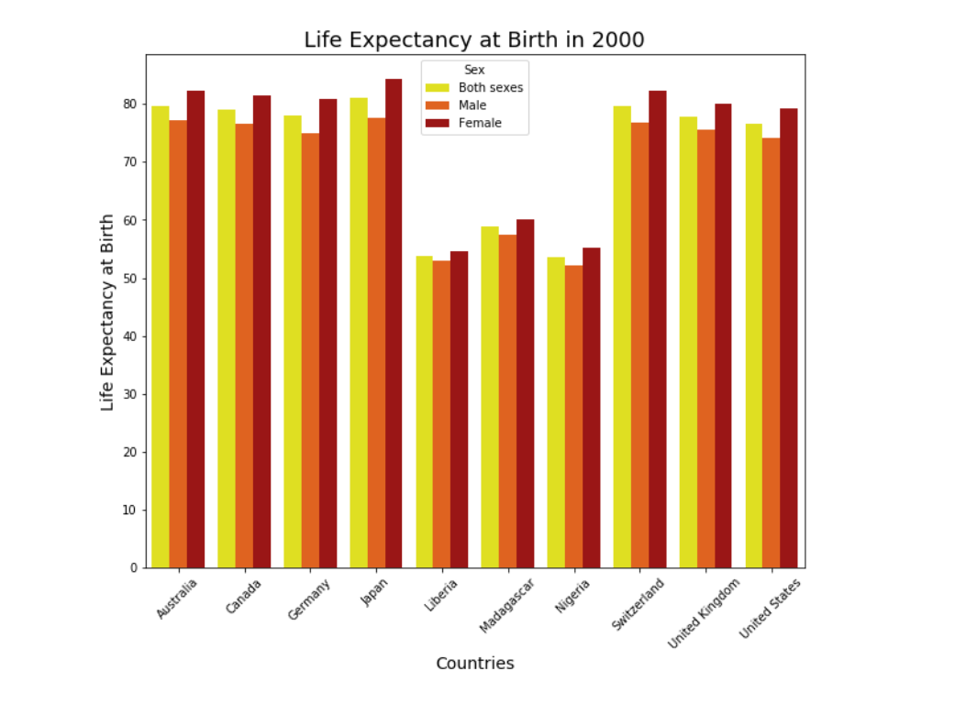
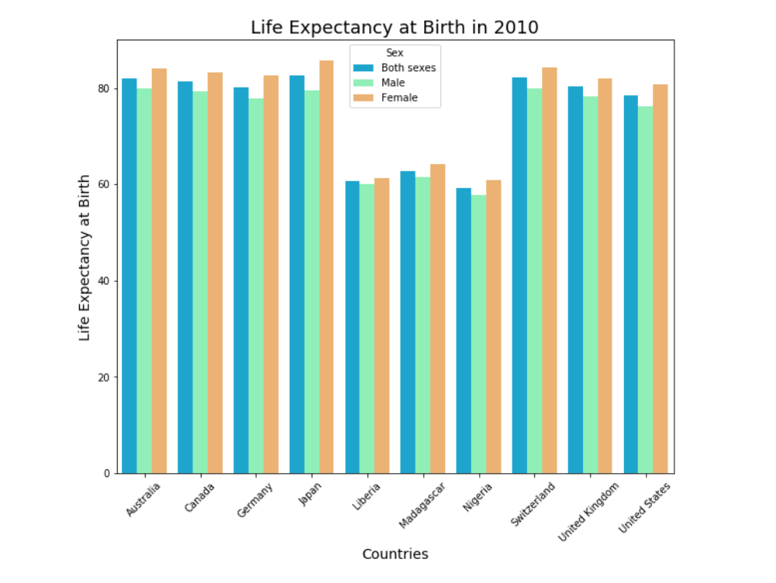
Sex: Both, Male, and Female

Slide 8
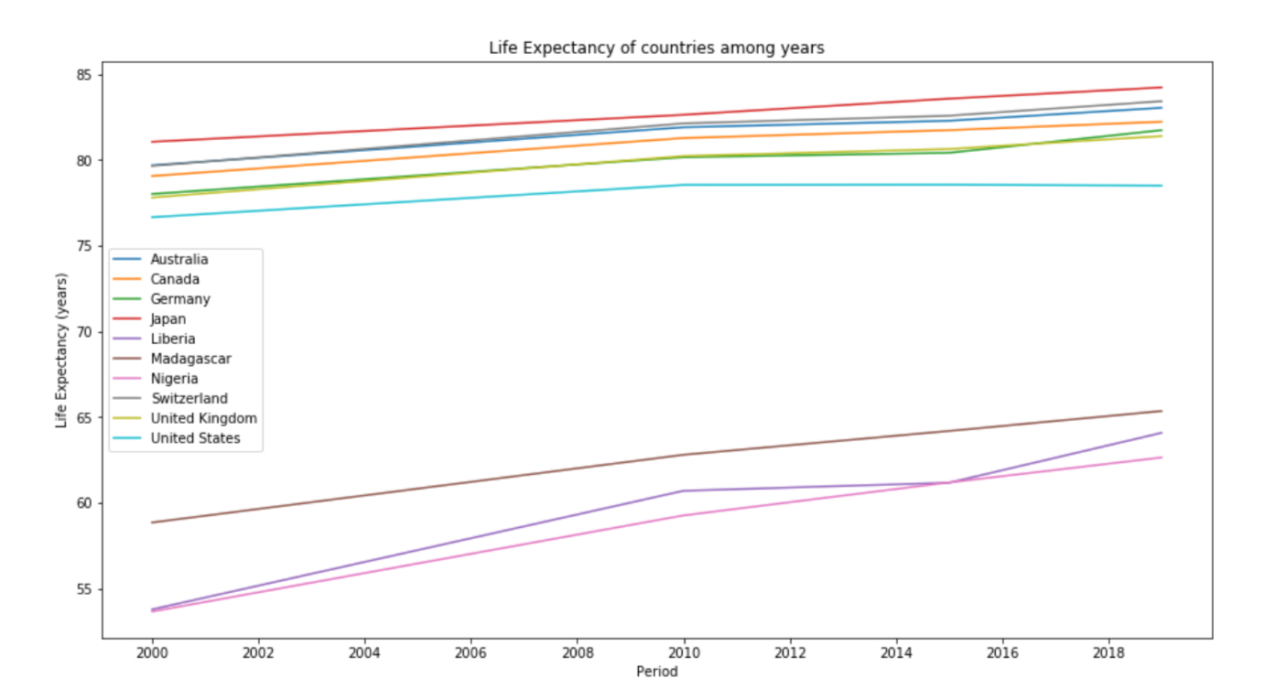

Slide 9
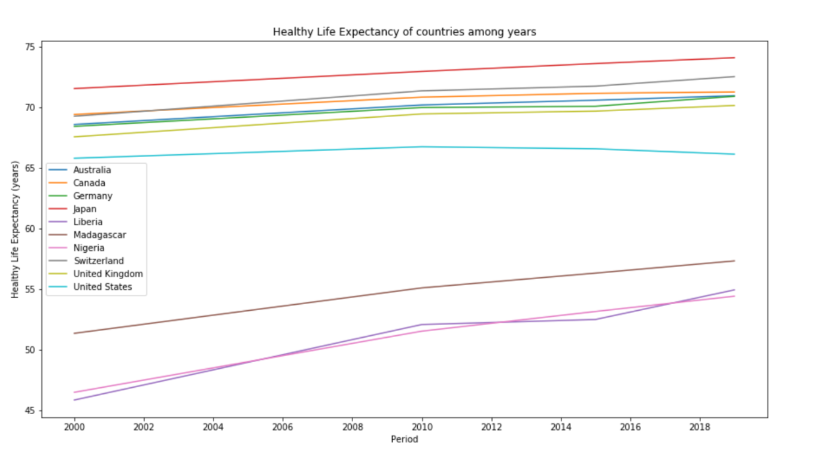

Slide 10
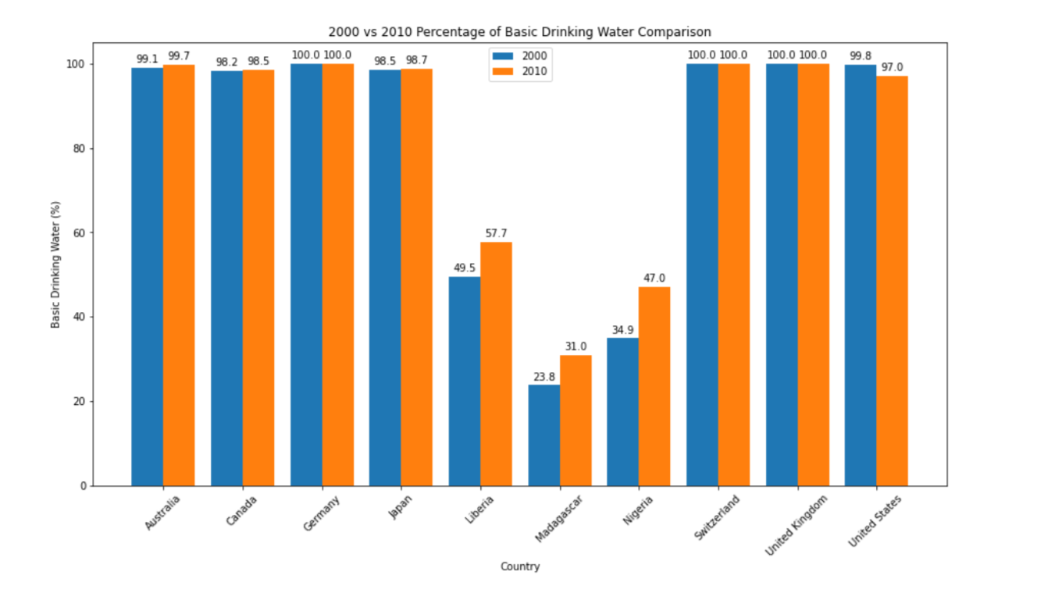
Basic drinking water services % 2000 versus 2010 - Top 7 countries have no changes (close to 100%) - Bottom 3 countries have improvements (from 20/50% - 30/60%)

Slide 11
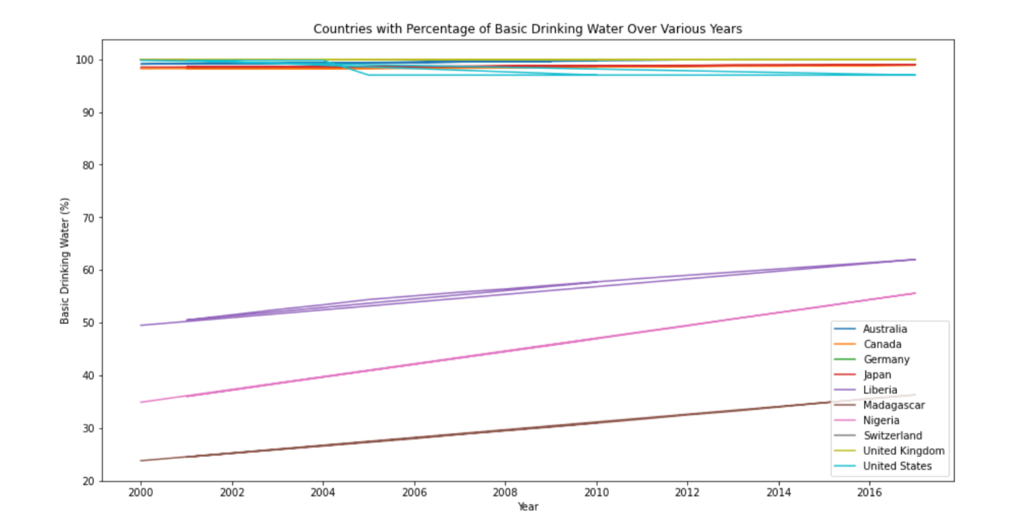
Basic drinking water services % from 2000 – 2017 - Top 7 countries have no changes (close to 100%) - Bottom 3 countries have improvements (from 20/50% - 30/60%)

Slide 12
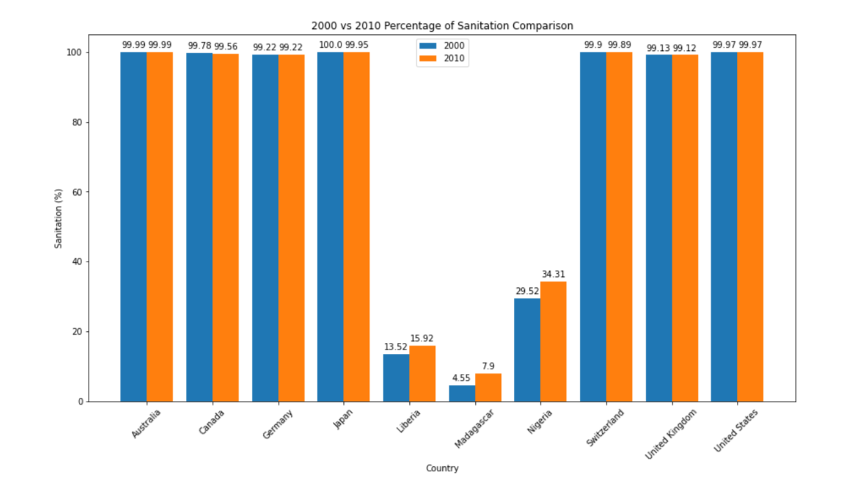
Basic sanitation services % 2000 versus 2010 - Top 7 countries have no changes (close to 100%) - Bottom 3 countries have improvements (from 5/30% - 8/35%)

Slide 13
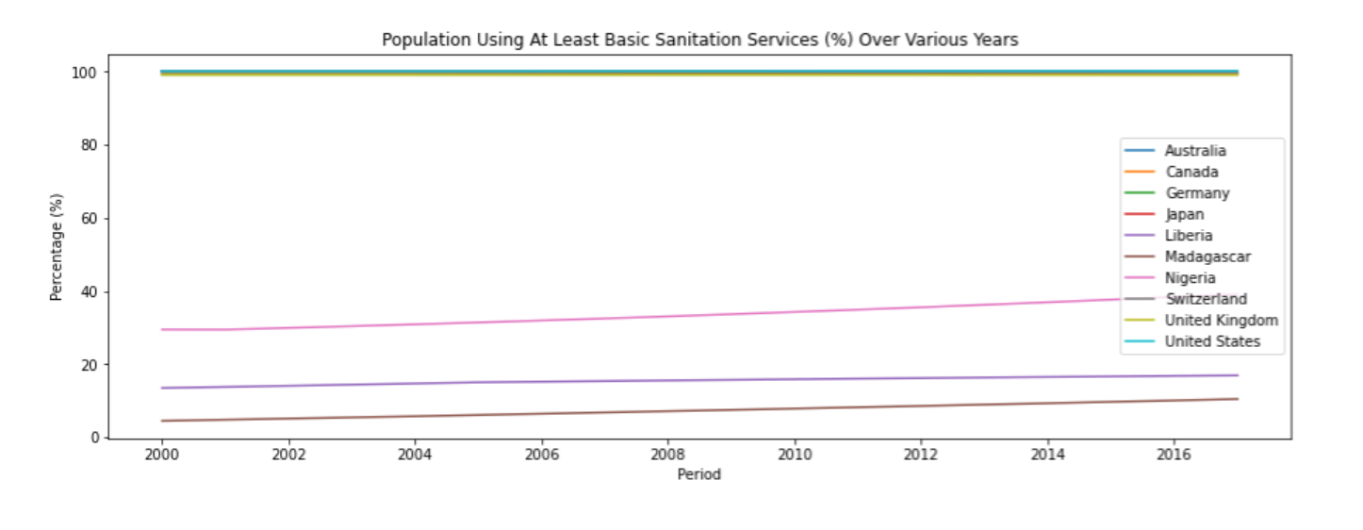
Basic sanitation services % from 2000 – 2017 - Top 7 countries have no changes (close to 100%) - Bottom 3 countries have improvements (from 5/30% - 8/35%)

Slide 14
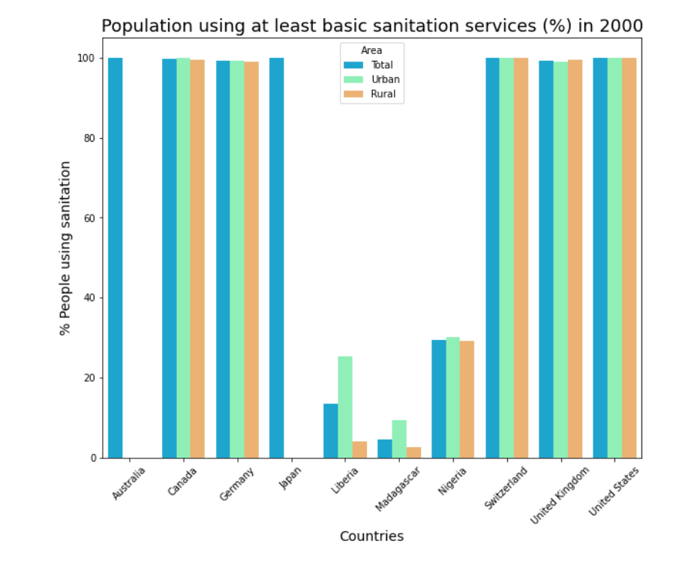
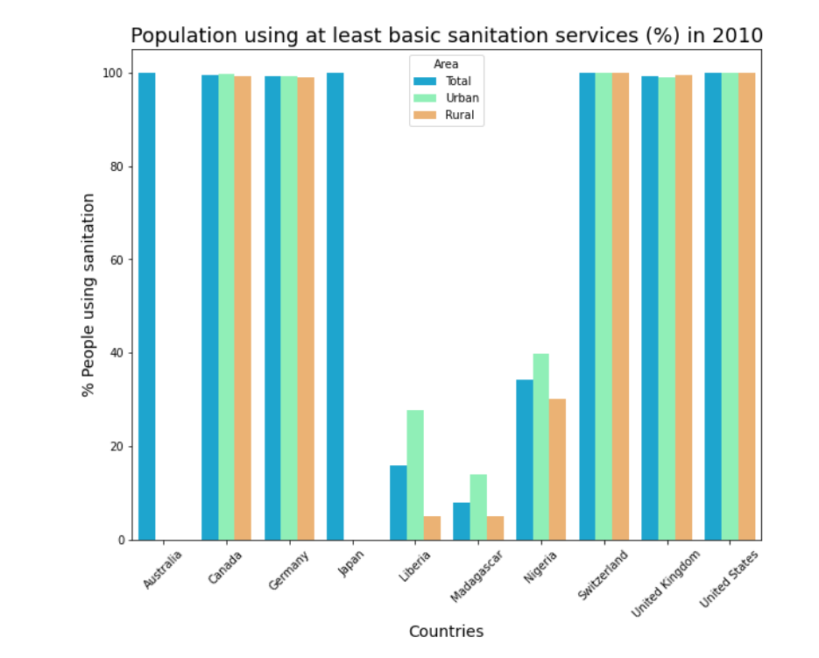
Area: Total, Urban, and Rural

Slide 15
Summarizing Major Findings
Top countries have the highest life expectancy while the bottom countries’ life expectancy is getting better
It appears drinking water and sanitation services does affect the bottom countries
Perhaps life expectancy rate and drinking water/sanitation have already improved if we can find a 2020 data set
This was a good reminder of how the basic services in life help us live a better and healthier life compared to those less fortunate and developed countries

